Slide 1



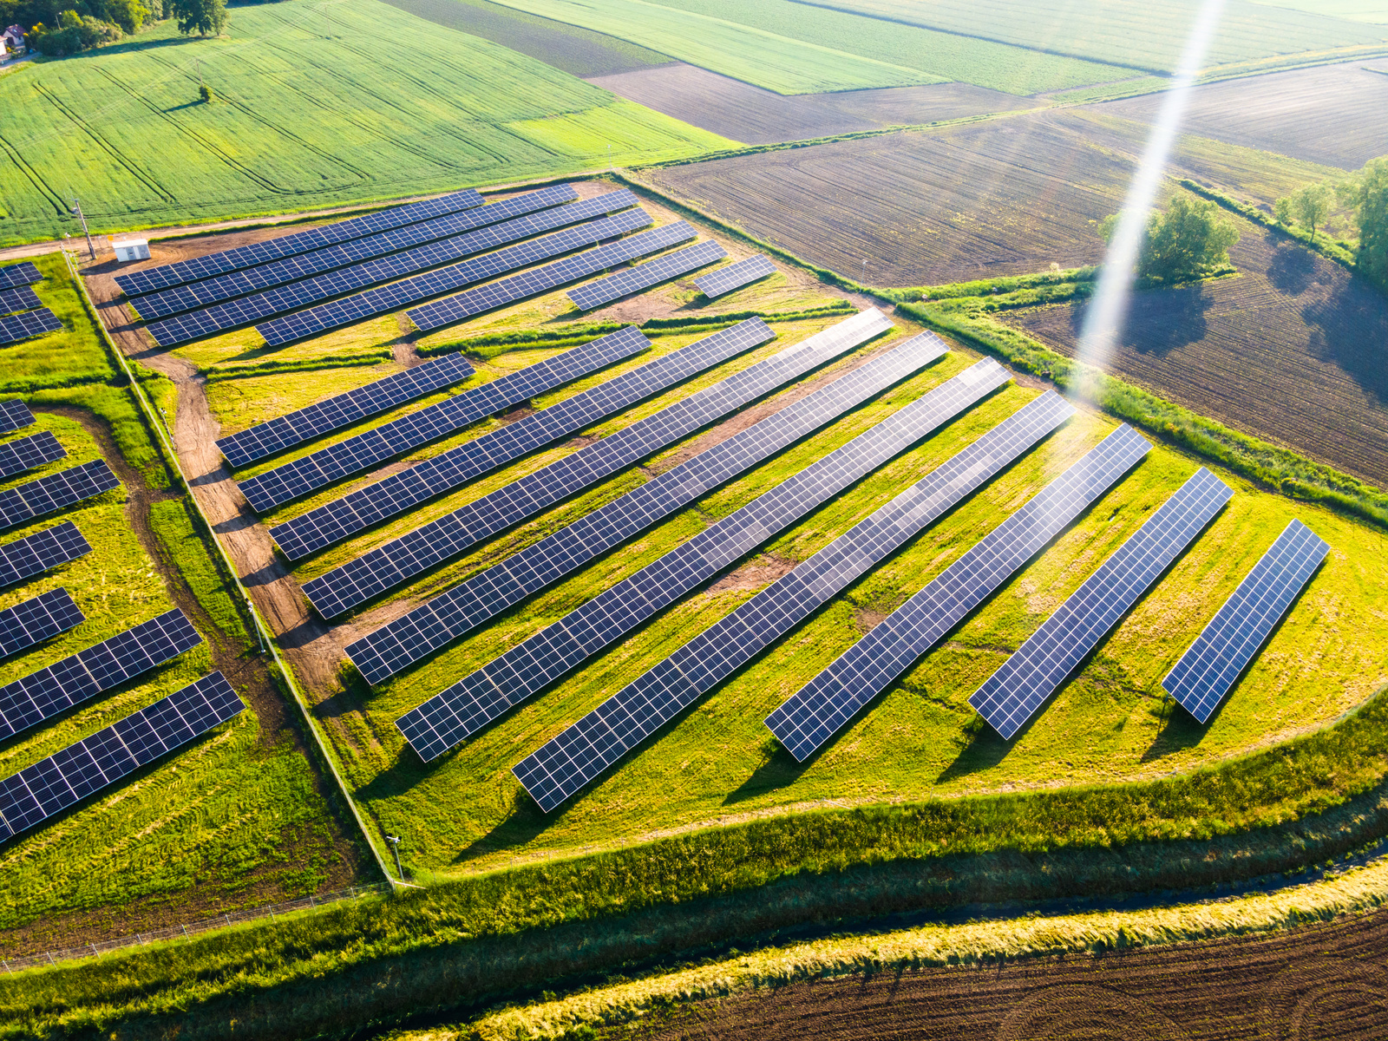

AIML CA 2
Predicting Energy Consumptions
Time Series
Goh Kun Ming
P2415691
DAAA/FT/1B/02

Slide 2
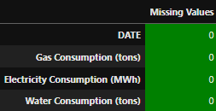
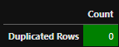
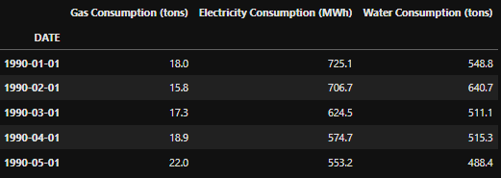
Data Cleaning and Analysis
Checking For Missing Data
Checking For Duplicated Data
Correcting Data Types and Setting Index

Slide 3
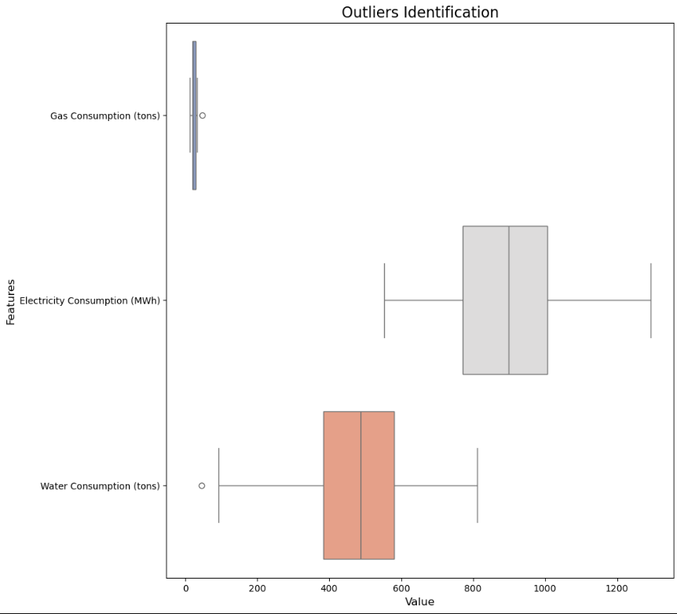
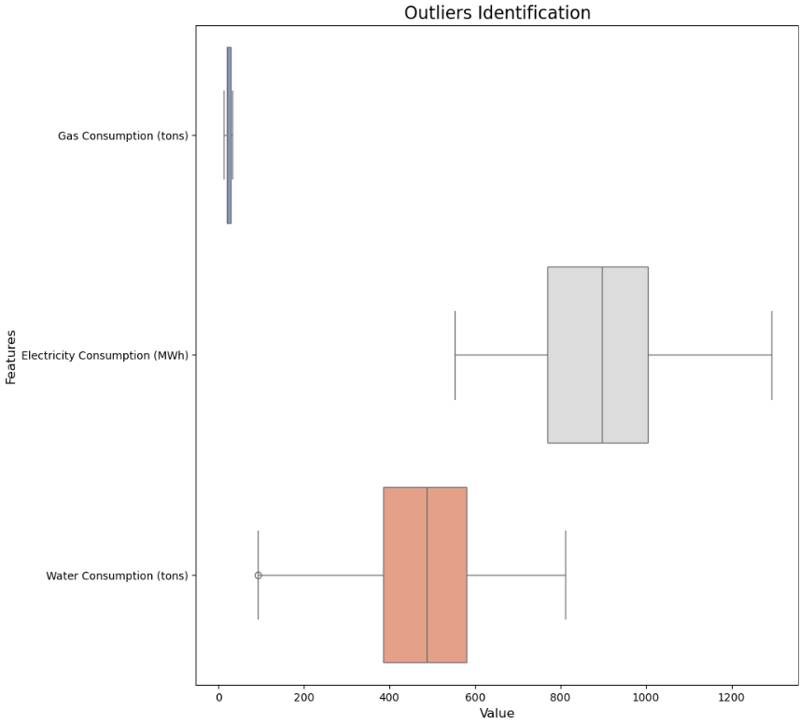
Data Cleaning and Analysis
Checking For Outliers
Addressing Outliers

Slide 4
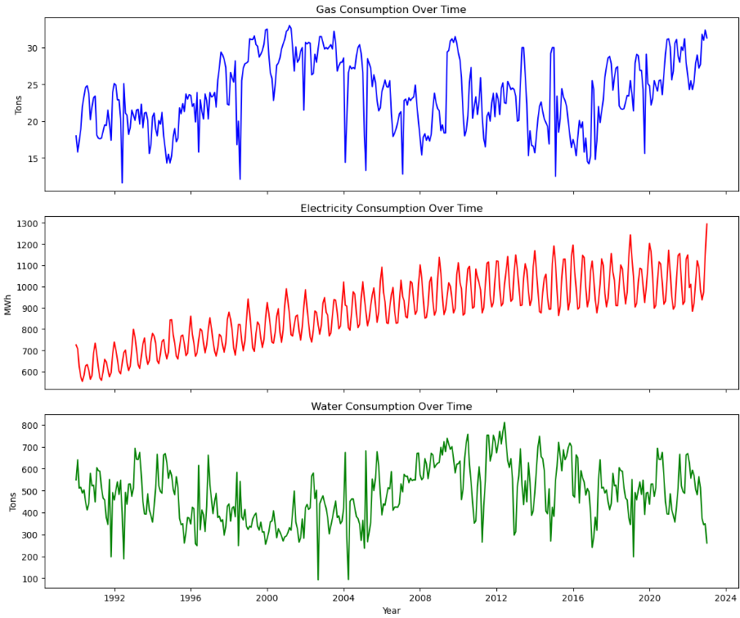
Univariate Analysis

Slide 5
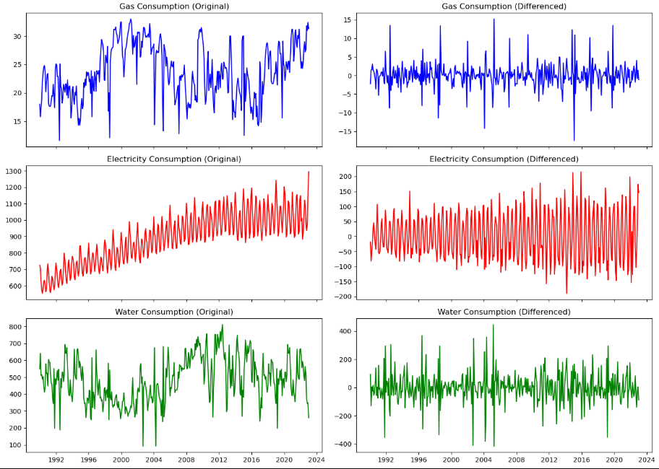
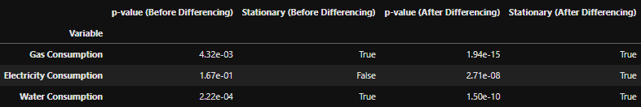
Time Series Analysis (ADF)

Slide 6
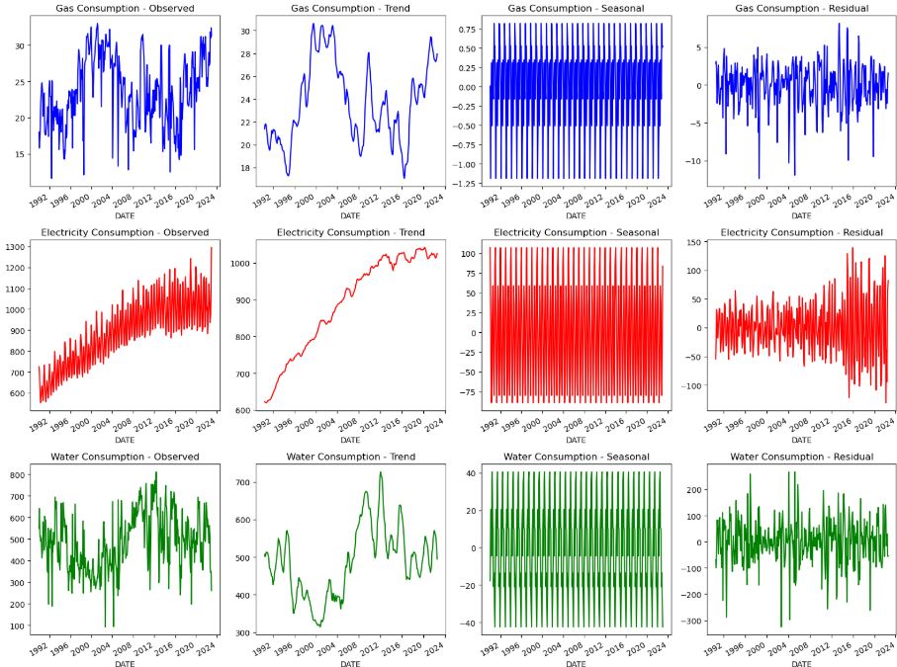
Time Series Analysis (Seasonal Decomp.)

Slide 7
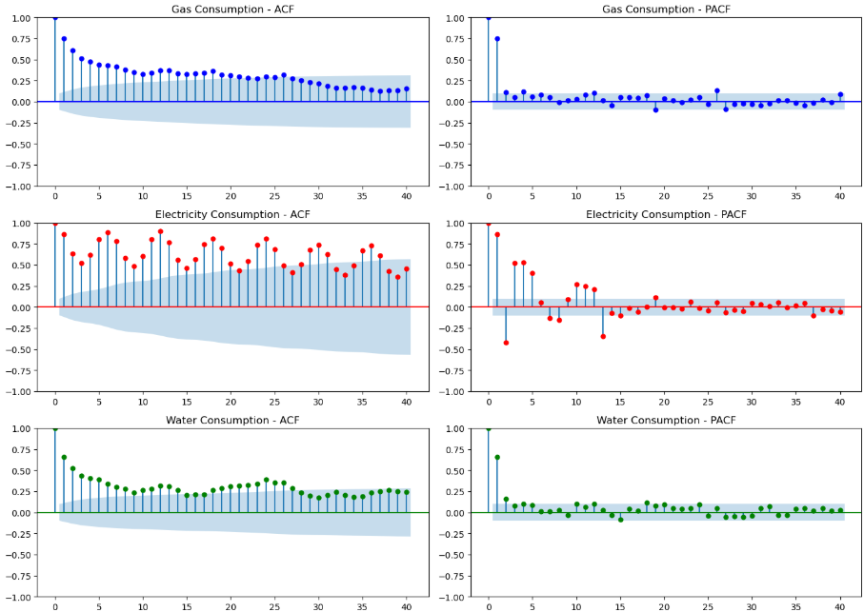
Time Series Analysis (ACF / PACF)

Slide 8
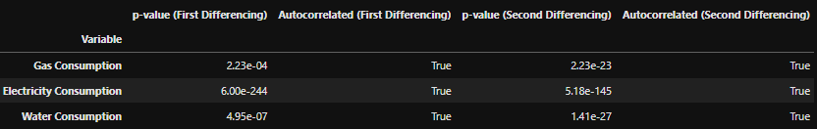
Time Series Analysis (Ljung-Box Test)

Slide 9

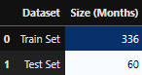
Data Pre-Processing
Data Logging
Train-Test Split

Slide 10
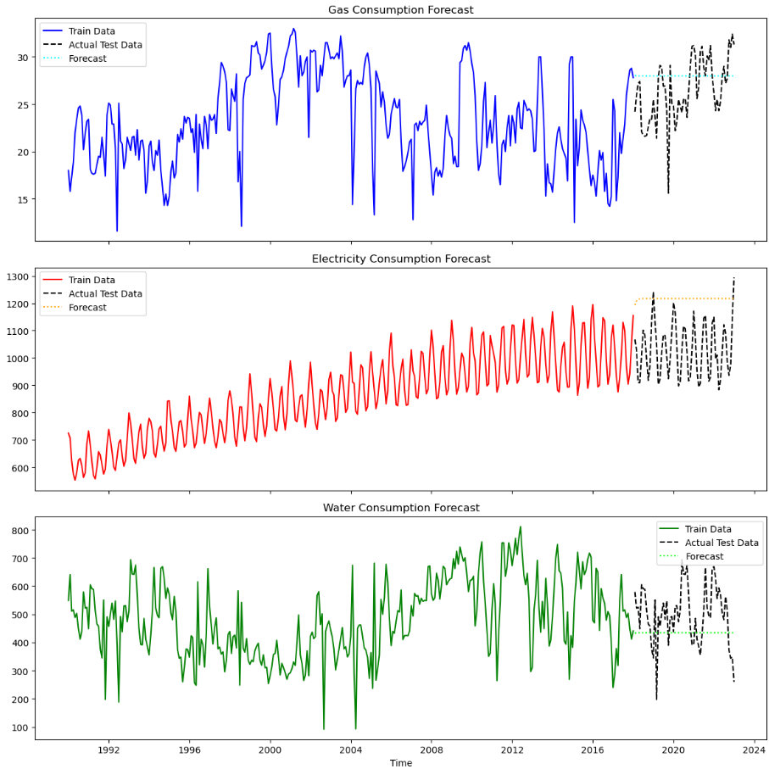
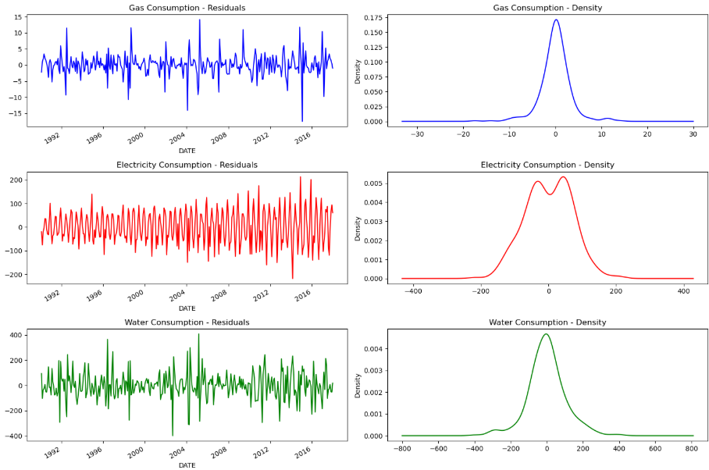
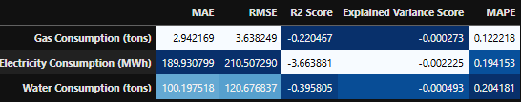
Baseline Model (ARIMA)

Slide 11
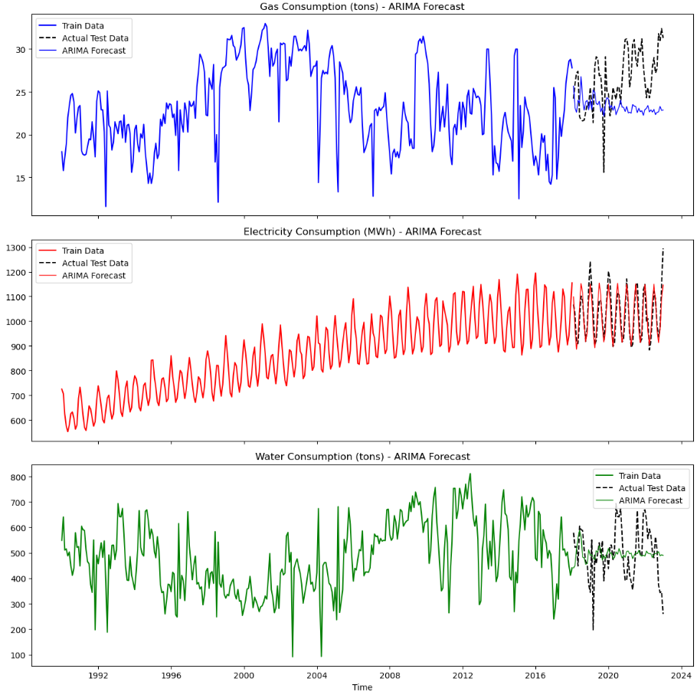
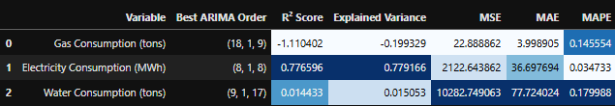
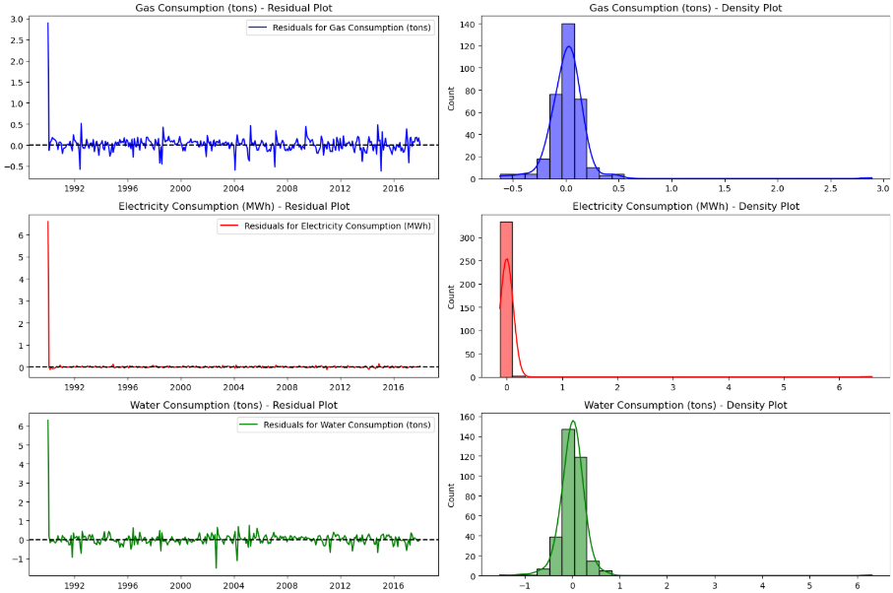
ARIMA Model
Grid Search’s Best Parameter

Slide 12

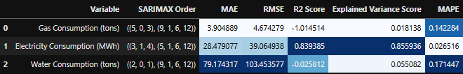
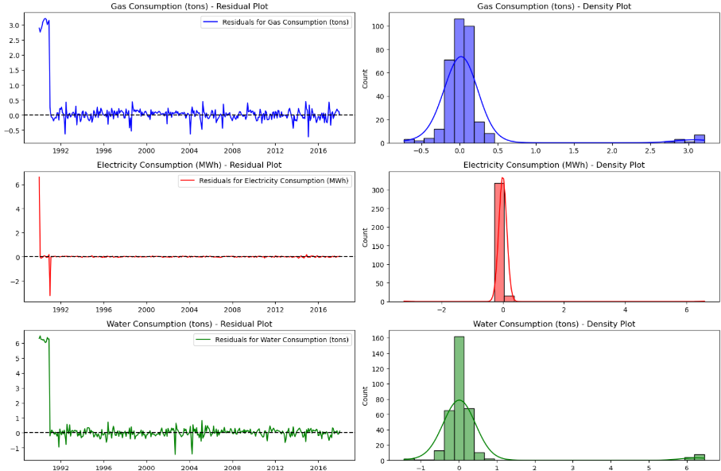
SARIMAX Model

Slide 13
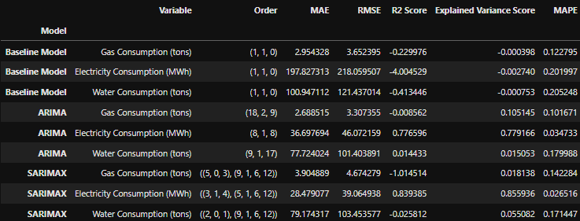
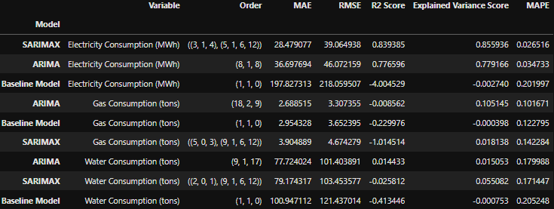
Model Evaluation and Selection
Evaluation
Selection

Slide 14
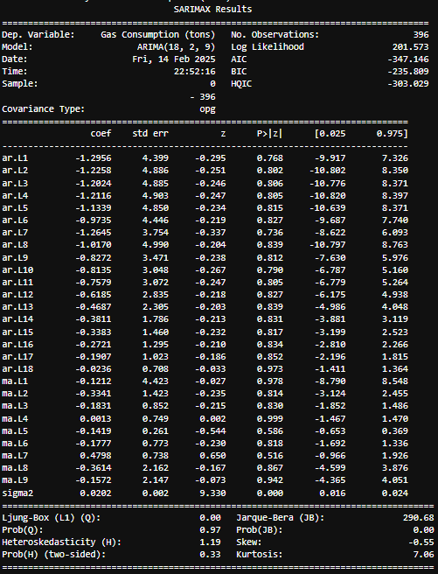
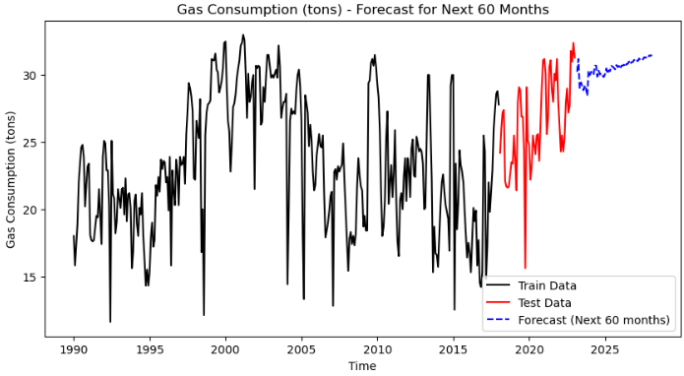
Model Deployment (Gas)

Slide 15
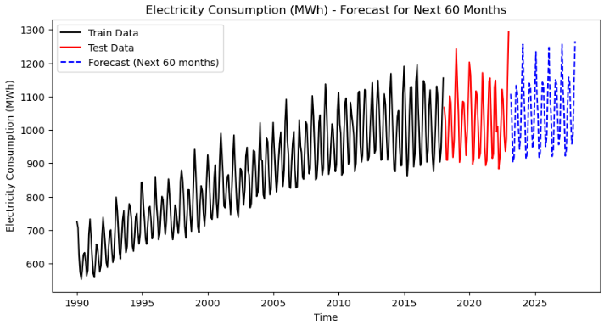
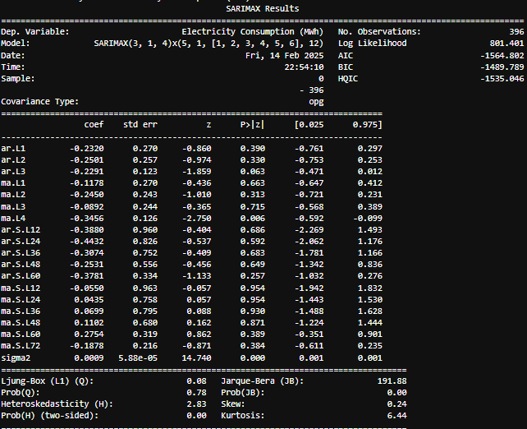
Model Deployment (Energy)

Slide 16
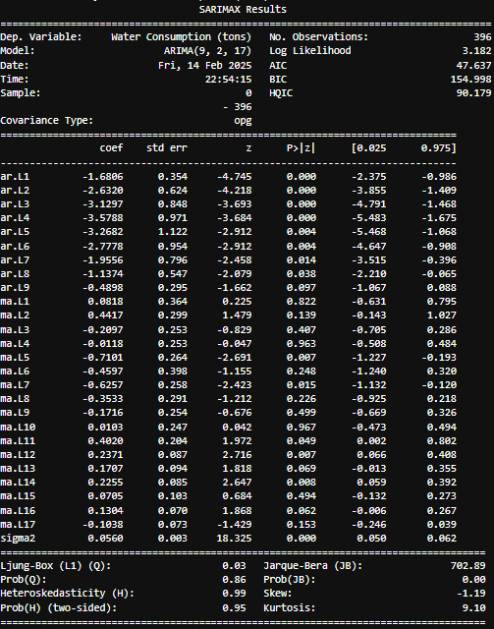
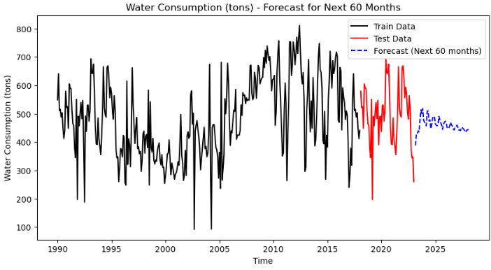
Model Deployment (Water)

Slide 17
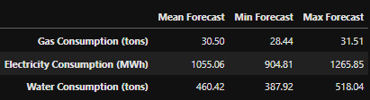
Overall Deployment

Slide 18
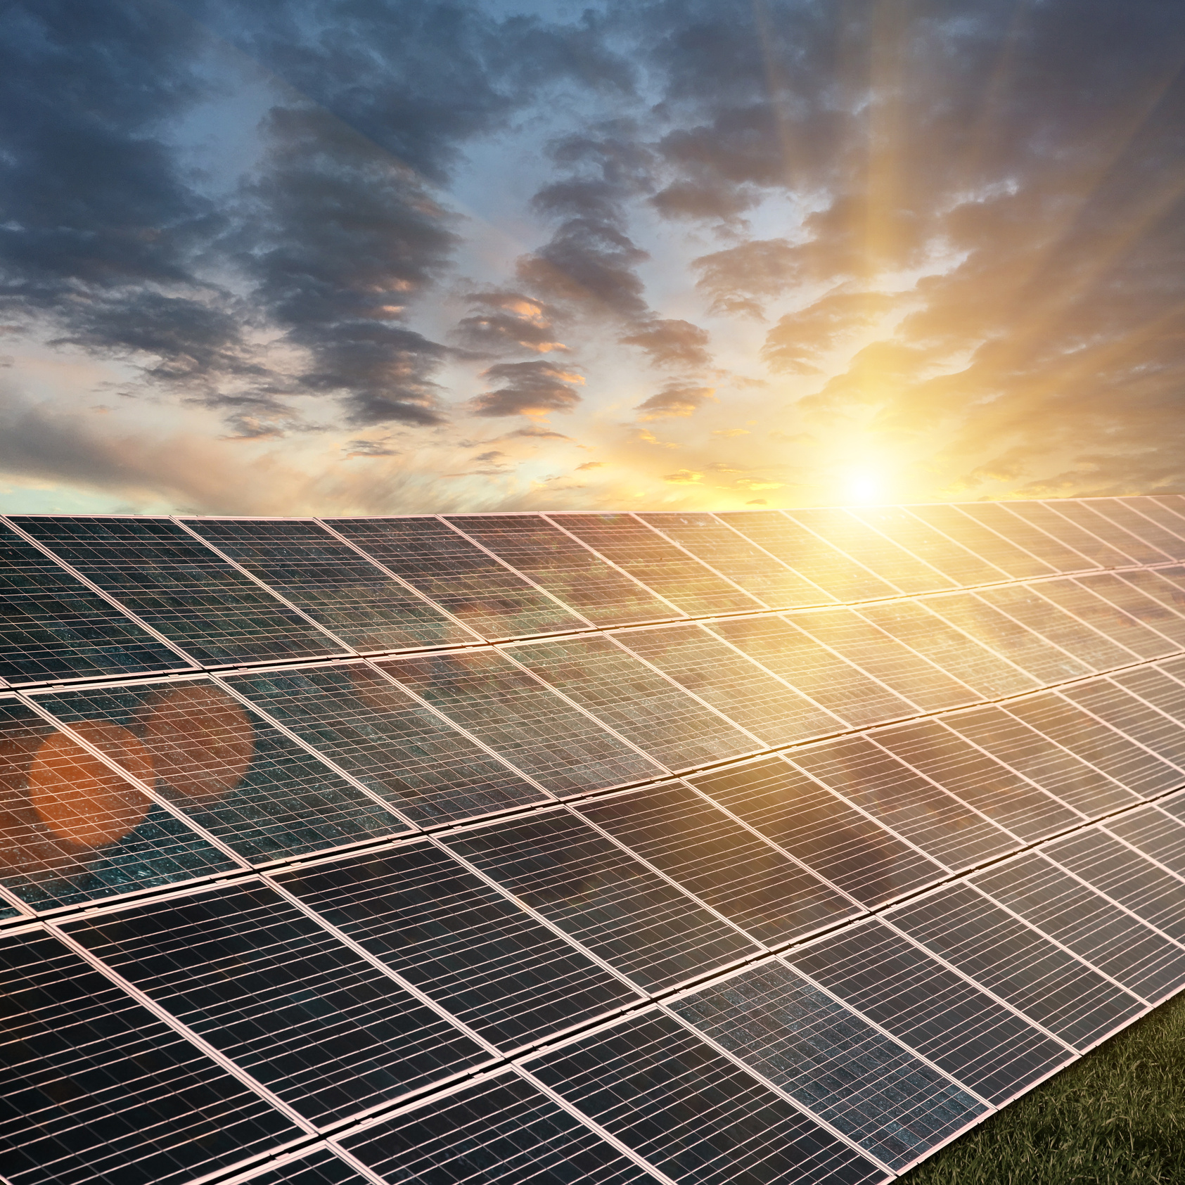


AIML CA 2
Thank You For Your Attention

